Slide 1
NCTN Clinical Trial Biospecimen Access The NCTN Core Correlative Sciences Committees (NCTN-CCSC) June 2025

Slide 2
NCTN-CCSC Mission Statement
Biospecimen collections developed from cancer clinical trials conducted by the NCI NCTN are highly annotated with carefully collected clinical data, including outcome data.
NCTN-CCSC is charged with scientific review & prioritization of proposals requesting use of banked, non-reserved biospecimens* collected from NCTN phase 2/3 and phase 3 trials for use in correlative science studies.
NCTN-CCSC has oversight for ensuring optimal use of these irreplaceable clinical trial biospecimens.
*These are specimens remaining after approved protocol-specified integral and integrated studies/endpoints have been completed.

Slide 3
NCTN Core Correlative Sciences Committee
Review committee with appropriate clinical, statistical, and scientific expertise to provide review & consideration of use of irreplaceable biospecimen resources.
As of January 1, 2019 there are two committees, A and B.
Proposals are assigned for committee review based on disease type.
CCSC-A:
Adult solid tumors
CCSC-B:
Hematologic malignancies
Pediatric and AYA cancers
Sarcomas
CCSC-A overflow

Slide 4
NCTN Core Correlative Sciences Committee Composition
CCSC-A and CCSC-B committees include:
NCTN Network Group Representatives
Translational science expertise
Disease expertise
Pathology
Patient advocates
Statisticians
Group Banking Committee representatives
NCI representatives

Slide 5
When are NCTN biospecimens available in Navigator*?
After:
NCTN trial completion
Clinical trial release from review by NCTN Data Safety Monitoring Committee or Group Statistical and Data Management Review (as applicable)
Reporting out of primary results, potential licensing application, & primary correlative endpoints
Investigators can search and submit requests for released specimens on the NCTN Navigator website.
*Release may be delayed if the study is supporting a marketing application

Slide 6
NCTN Navigator: Steps to Biospecimen Access
Review
Specimens
and Trial Publications
LOI Initial Feasibility
Review
(FDS/Group)
Proposal
Scientific Review (NCTN-CCSC)
Requires
CTEP-IAM
Account
Explore
Website
Search for
Specimens
Consider
Scientific
Question
Submit
LOI
Submit
Proposal
NCTN Navigator is a mechanism through which to search biospecimen availability from completed legacy and NCTN phase 2/3 and 3 studies.
https://navigator.ctsu.org/navigator/login

Slide 7
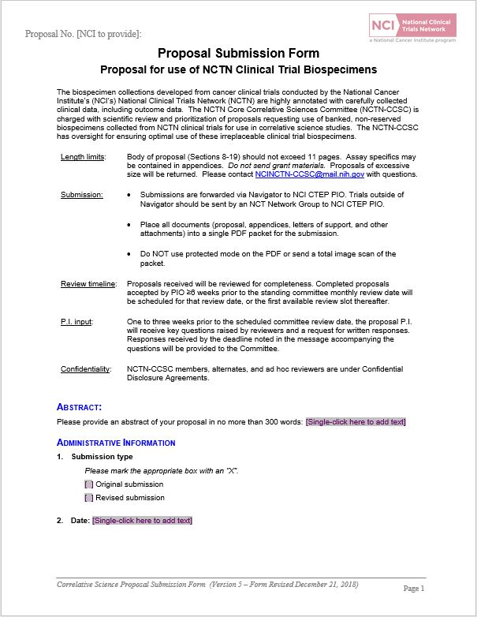
NCTN Clinical Trial Biospecimens Proposal Submission
LOIs determined to be feasible are prompted to submit a research proposal through Navigator.
Proposal Review:
NCTN-CCSC Review
Phase 2/3 or 3 trials
NCI Programmatic (CTEP) Review
All other trials
Expedited Review (case-by-case)
Note: Funding is not required for proposal submission.

Slide 8
NCTN-CCSC Review Workflow
* Proposals may be reviewed by NCI CRADA or NCTN Group collaborator(s) per existing agreements

Slide 9
Investigator Responsibilities
Upon study approval, the investigator is responsible for:
Notifying the Group holding specimens of study funding
Ascertainment of IRB/Ethics Committee approval for receipt of biospecimens
Network Bank MTA for biospecimens
Data use agreement with NCTN statistical center(s) for clinical data
Submission of primary publications to NCI (following regular NCI publications policy)
Adherence to IP option if collaborative agreement
Notification to NCI before sharing data from the study via a publicly available database

Slide 10
Tips for Successful Specimen Requests
Specimen request review is not the same as a grant review – Respond to the proposal prompts!
Work with your biostatisticians
“Machine Learning” requires full description of methods used for the model and how it is being applied
Clearly describe any cutpoints, clustering, or subject classification schemes
Avoid common pitfalls:
Using prognostic and predictive interchangeably – different meaning, different statistics
Too many aims, subaims (this is not an R01 application)
Background does not support primary aim
Assay characteristics details are not included
Poor statistical section (most common reason for disapproval)

Slide 11
Questions? Contact us
NCTN-CCSC (Core Correlative Sciences Committee):
NCINCTN-CCSC@mail.nih.gov
Navigator Front Door Service (help desk): navigatorcontact@imsweb.com
Protocol Information Office (PIO):
pio@ctep.nci.nih.gov

